Slide 1
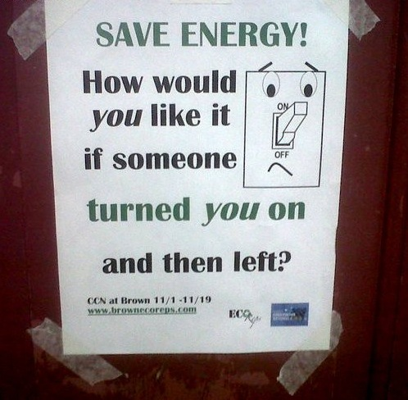
This lesson
Principle of conservation of energy
Efficiency

Slide 2
Do now!
Can you talk to the person next to you about what the word ENERGY means.
DO NOW!
A potato ‘getting it on’

Slide 3
What is Energy?

Slide 4
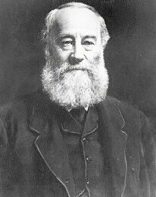
What is Energy?
“The capacity to do work”
Not a very good definition!
Notes:
The picture is of Joule

Slide 5
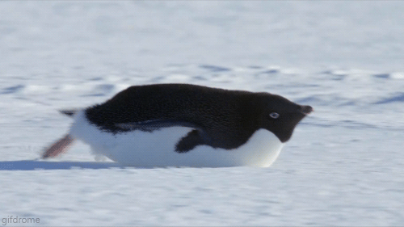
Let’s try to understand what energy is.
Energy can take many forms;

Slide 6
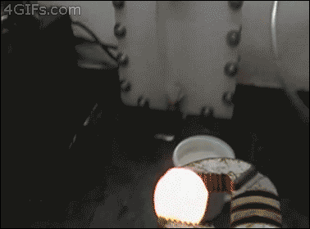
Heat

Slide 7
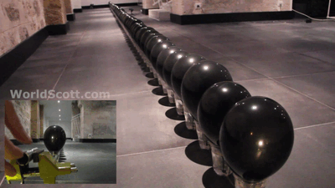
Light

Slide 8
Sound

Slide 9
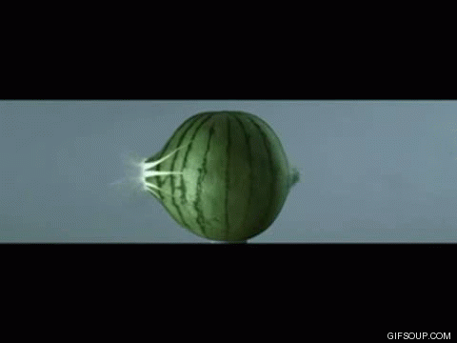
Kinetic (movement)

Slide 10
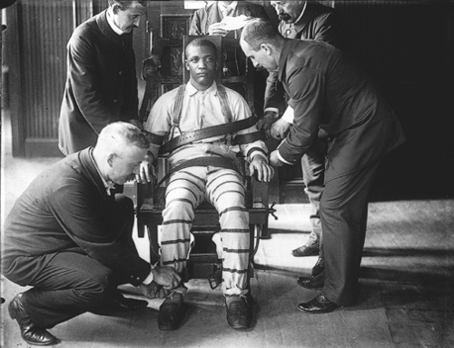
Electric

Slide 11
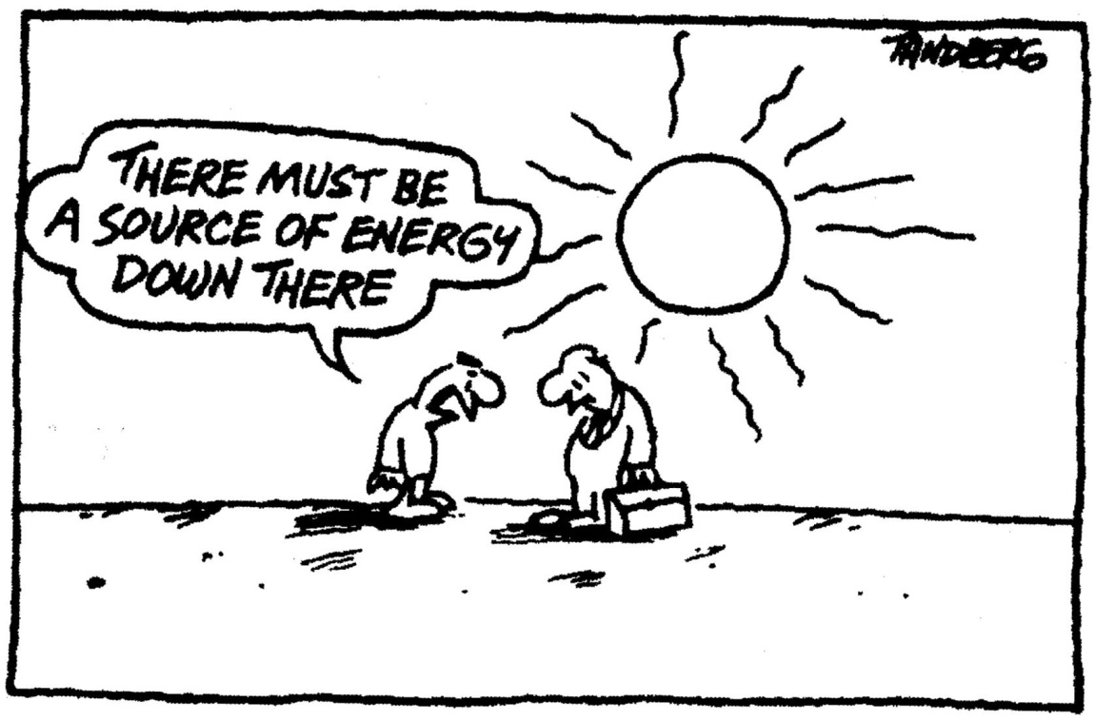
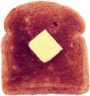
Chemical

Slide 12
Gravitational potential

Slide 13
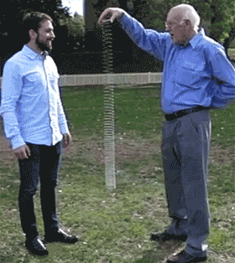
Elastic/Strain

Slide 14
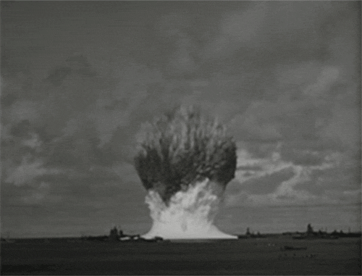
Nuclear

Slide 15
Types of Energy
Heat Chemical
Light Gravitational
Sound Elastic/Strain
Kinetic Nuclear
Electric

Slide 16
Types of Energy
Heat Chemical
Light Gravitational
Sound Elastic/Strain
Kinetic Nuclear
Electric
Stored/potential

Slide 17
The Law of Conservation of Energy
Energy can be changed (transformed) from one type to another, but it can never be made or destroyed.

Slide 18
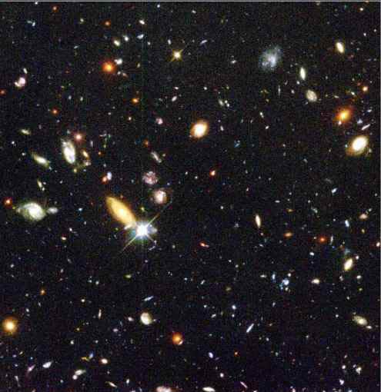
This means that the total amount of energy in the Universe stays the same!

Slide 19
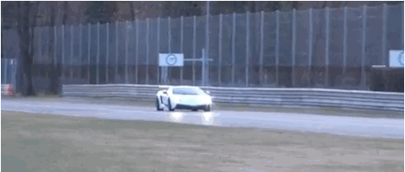
Energy Flow diagrams
We can write energy flow diagrams to show the energy changes that occur in a given situation. When a car brakes, its kinetic energy is transformed into heat energy in the brakes.
Kinetic heat

Slide 20
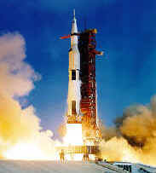
Other examples
When a rocket launches.

Slide 21
Other examples
When a rocket launches.
Chemical kinetic (+ sound + heat) gravitational

Slide 22
Other examples?
Notes:
Get class to discuss the changes here

Slide 23
Other examples?
Notes:
Get class to discuss the changes here

Slide 24
Other examples?
Notes:
Get class to discuss the changes here. You could demonstrate this with iron wool and a 9V cell.

Slide 25
Energy Circus
Around the room are a few examples of energy changes (some simple, some a little more complicated!)
For each example NEATLY write the energy flow diagram on the worksheet.
You will have 2 minutes on each example.
Notes:
Set up lots examples of energy transformations and get class to write energy flow diagrams for each one. Pendulum, mass on a spring, flashlight, Hero’s engine etc.

Slide 26
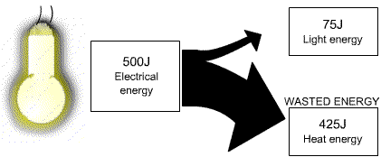
Sankey Diagram
A Sankey diagram helps to show how much light and heat energy is produced

Slide 27
Sankey Diagram
The thickness of each arrow is drawn to scale to show the amount of energy

Slide 28
Sankey Diagram
Notice that the total amount of energy before is equal to the total amount of energy after (conservation of energy)

Slide 29
Efficiency
Although the total energy out is the same, not all of it is useful.

Slide 30
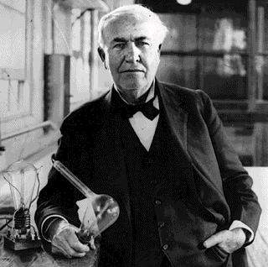
Efficiency
Efficiency is defined as
Efficiency = useful work out = useful power out
total work in total power in

Slide 31
Example
Efficiency = 75 = 0.15
500

Slide 32
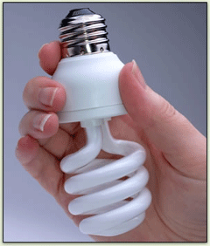
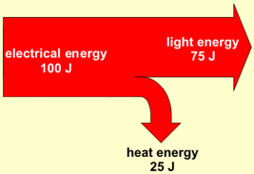
Energy efficient light bulb
Efficiency = 75 = 0.75
100

Slide 33
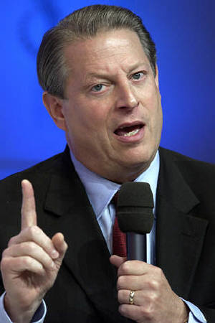
Energy efficient light bulb
Efficiency = 75 = 0.75
100
That’s much better!

Slide 34
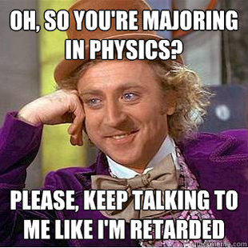
2.3 Efficiency and Sankey diagrams

